Slide 1

Cascading style sheets
Introduction to web design bootcamp – University of Limerick

Slide 2

Main Points
What is CSS?
The Basics
The 30 selectors you’ll use most
Specificity
@Media Queries
Assignment
This Photo by Unknown Author is licensed under CC BY-SA

Slide 3
What is CSS?
CSS stands for Cascading Style Sheets
It’s how we adapt the appearance of the elements on a page
It allows us to separate the content (which is the HTML tags and their content) from the appearance
This makes for easier to update and maintain websites and also cuts down on the amount of work we have to do
REMEMBER: Don’t Repeat Yourself (DRY)

Slide 4
The Basics (1)
It can be added either:
  Inline – using a style attribute on each element we wish to change (not recommended except in testing phase)
  Internal – using the style tag in the head of the document – better approach but not as reusable – useful for testing small changes or where a single page needs minor changes
  External – using the link tag to point our page at an external stylesheet (a file with extension .css where our CSS rules are stored)
The general format of a CSS rule is:
  selector { property: value; }
  All parts of this are required
    selector identifies the element we wish to change
    property is the aspect of the element we wish to change
    value is the new value of the property
    : (colon) separates a property and a value – equivalent of equals sign
    ; (semi-colon) indicates we have finished providing a value
    { } (the curly brackets) indicate the start and end of a CSS rule

Slide 5
The Basics (2)
A list of CSS properties and selectors is available at :
  https://overapi.com/css
  https://www.w3schools.com/css/
We’re going to look at the 30 most useful selectors next and introduce properties as we need them

Slide 6
The 30 selectors you’ll use most
*
#X
.X
X Y
X
X:visited and X:link
X > Y
X + Y
X ~ Y
X[attribute]
X[attribute=“value”]
X[attribute*=“value”]
X[attribute^=“value”]
X[attribute$=“value”]
X[data-*=“value”]
X[data-*~=“value”]
X:checked
X::after and X::before
X:hover
X:not(Y)
X::pseudoElement
X:nth-child(n)
X:nth-last-child(n)
X:nth-of-type(n)
X:nth-last-of-type(n)
X:first-child
X:last-child
X:only-child
X:only-of-type
X:first-of-type

Slide 7
Specificity
What if we have conflicting rules? Or a rule fails?
Specificity gives us a way to decide what rule wins
As the name suggests it’s based on how specific a rule is – the more specific the more likely it is to be applied
    * is least specific (in fact counts as zero)
    Element selector
    Classes, attributes, and pseudo-classes
    IDs
    Inline styles
    !important
Visit https://cssspecificity.com/ for a fun chart to help remember

Slide 8
@Media Queries (1)
One last complication: how do I know what size screen the person is viewing my website on?
Our design will look great on our screen (and for anyone who has the same sized screen) but what if their screen is much bigger? Or smaller?
We can use relative sizing (% or em or rem) but there are limits with this and being proportionally the same size doesn’t mean it will look well
Instead we can use media queries
These allow for us to change the rules that apply to our elements based on criteria, usually:
  width and height of viewport or device
  orientation (landscape or portrait)
  resolution

Slide 9
@Media Queries (2)
The general form of the query is:
  @media not|only mediatype and (expressions) {
    //css code goes here
  }
For example: suppose we have two divs of class panel which we want side by side and 540px wide:
  div.panel {
    width:540px;
    float:left;
  }
On a smaller screen only one of these is completely visible so let’s make them stack on top of each other instead on a smaller screen:
  @media screen and (max-width: 600px) {
    div.panel {
      width:100%;
      float:left;
    }
  }

Slide 10
Assignment
Two assignments this time.
  On the next slide you’ll find a layout for the csszengarden.com index.html file. Try and replicate this layout as closely as you can by updating the style.css file. Some hints have been provided but remember:
  DO NOT MAKE ANY CHANGES TO THE INDEX.HTML FILE!!
  Again using the index.html file from csszengarden.com, create your own style design for this webpage. Be as imaginative as you like and when finished, upload a screengrab of the webpage to the forum for your classmates to see.

Slide 11
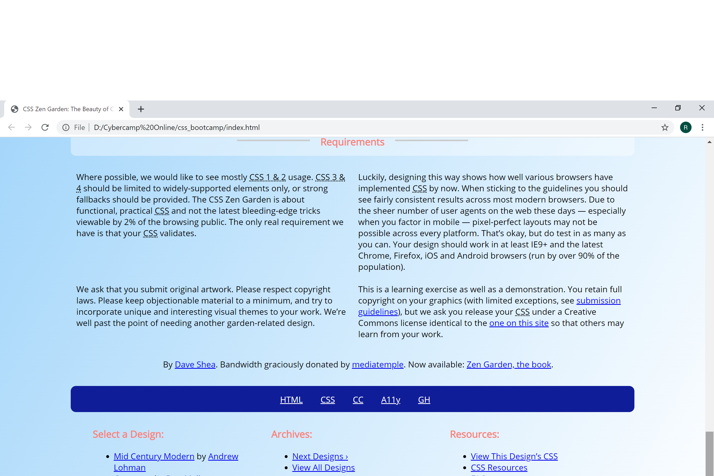
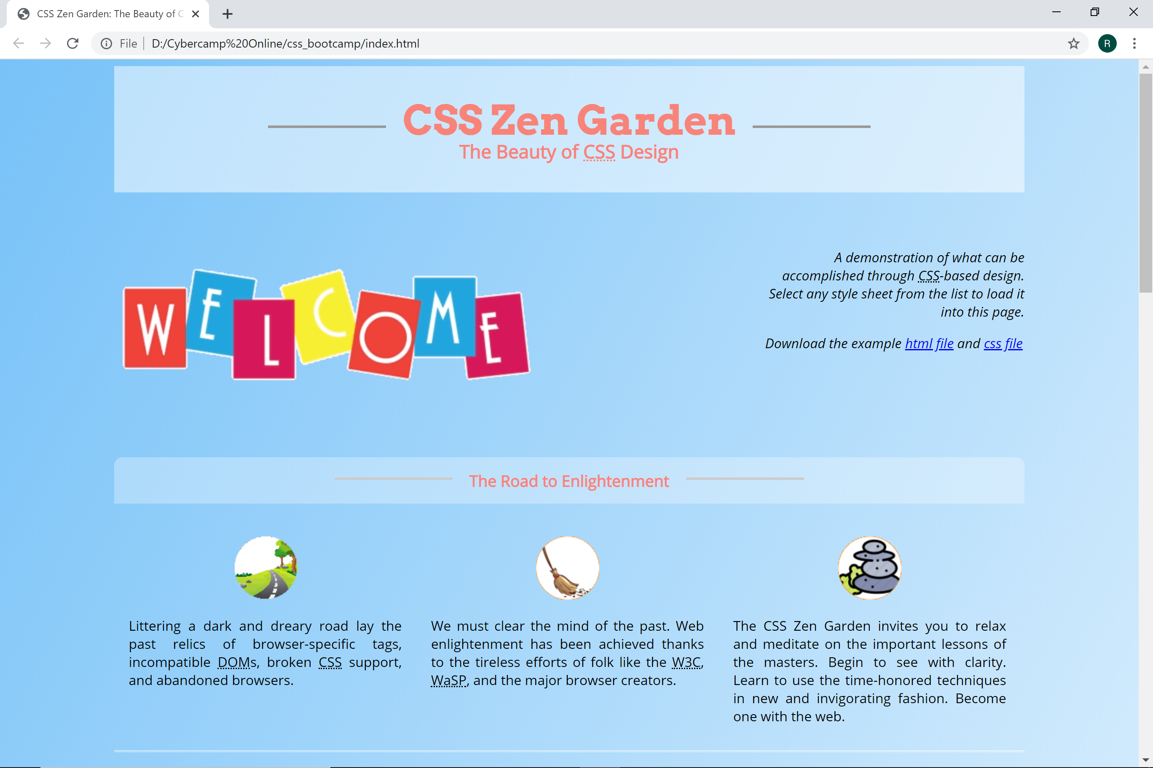
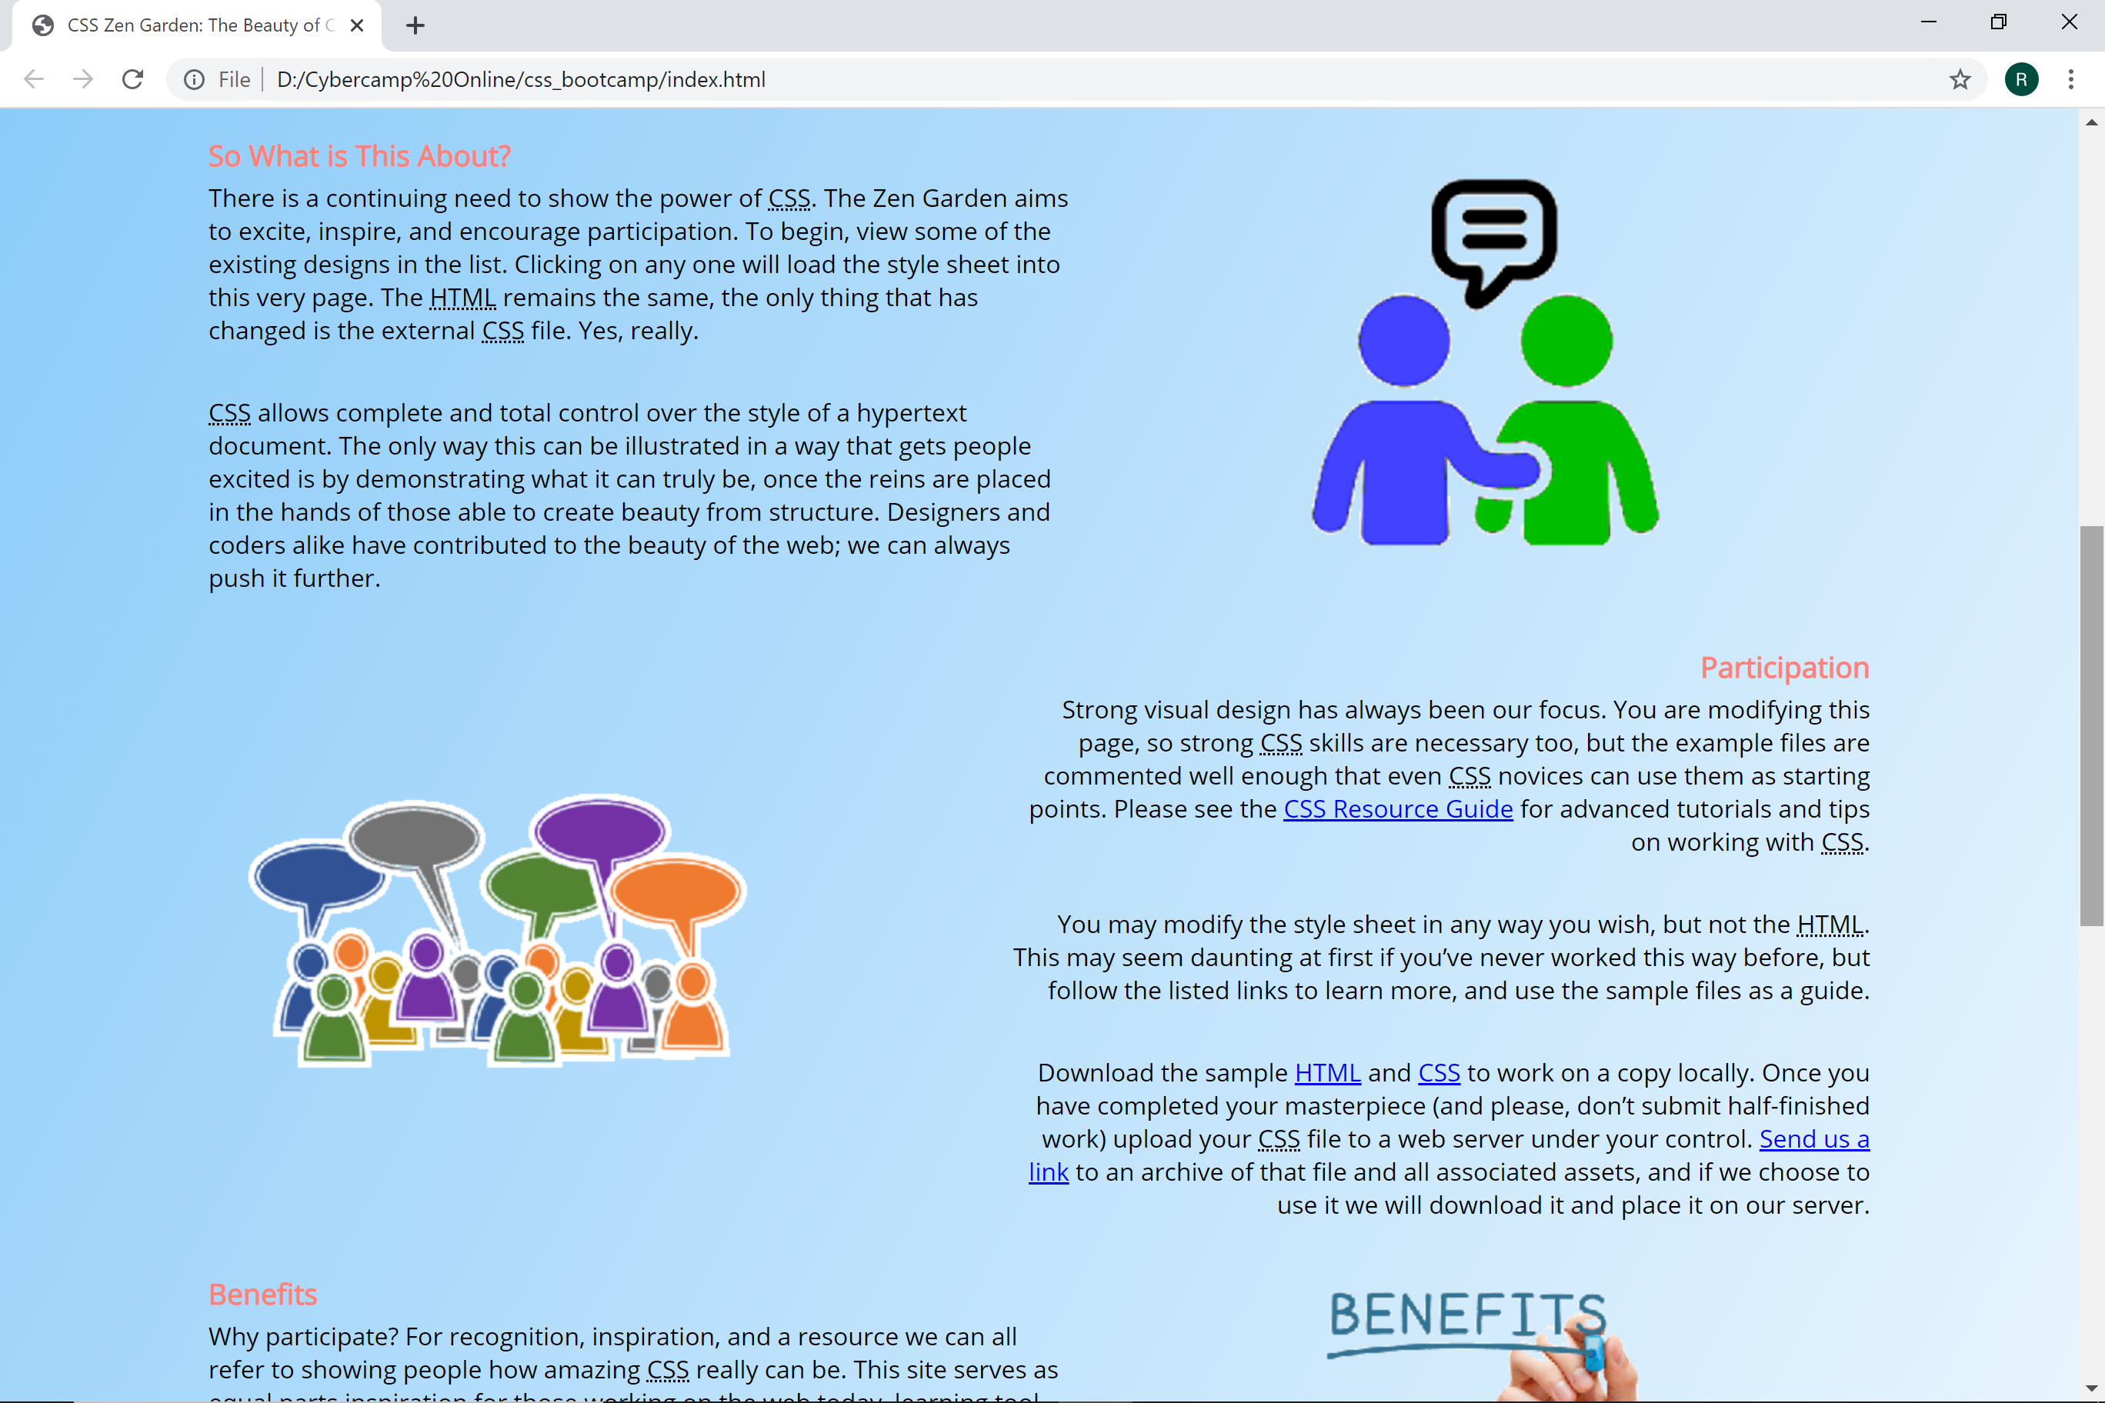
Top of the page
Set for 1080px wide
I’ve used Arvo and Open Sans fonts
Colors used are #77C2F8, #F88379,
#101D98, white and various greys
Icon and other images provided
Middle of the page
Get the sections to float left and right
Use the pictures provided
End of the page
4 of 5 paragraphs floating beside each other
Use rounded borders
@import url('http://fonts.googleapis.com/css?family=Arvo:700|Open+Sans:400italic,400');

