Slide 1
Introduction
Introduction to web design bootcamp – University of Limerick

Slide 2
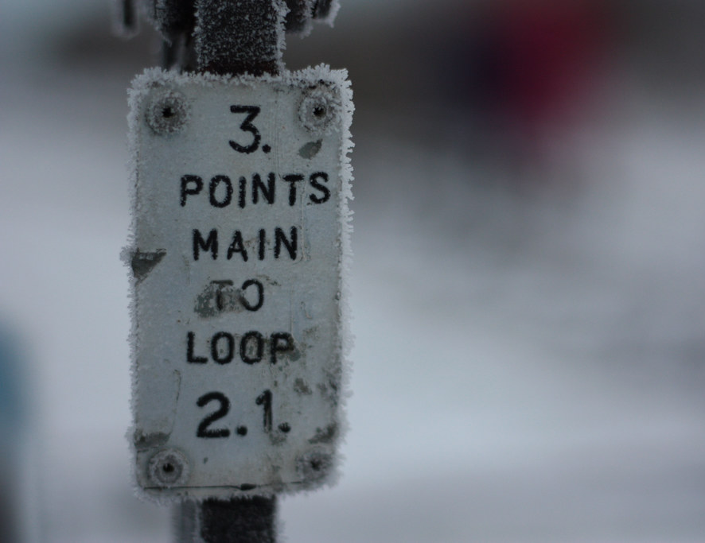
Main Points
What is the Internet?
How does it work?
How do webpages work?
What software will we need?
This Photo by Unknown Author is licensed under CC BY-SA

Slide 3
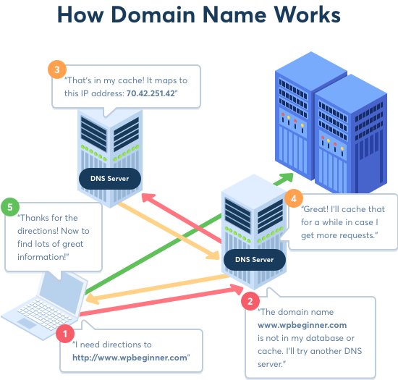
The web – how we find things

Slide 4
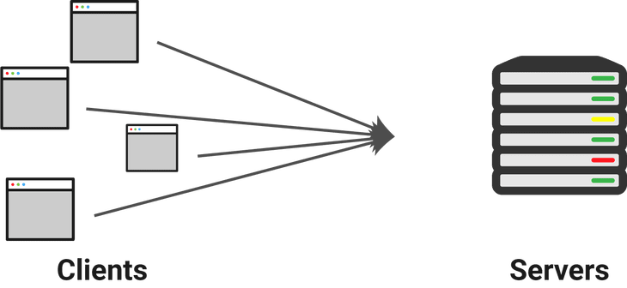
Clients and servers

Slide 5
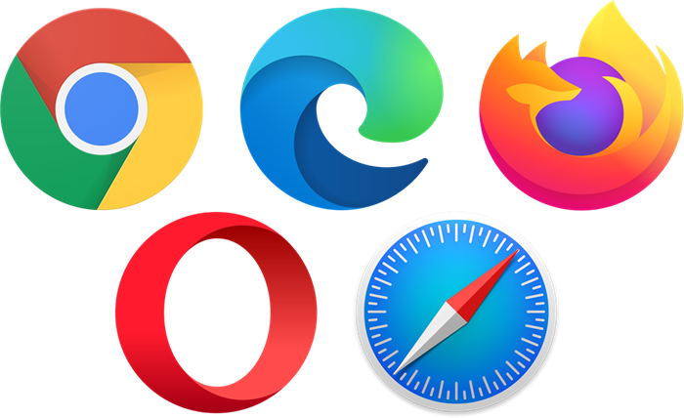
Browsers

Slide 6
SOFTWARE for this course - Google Chrome - VSCODE

Slide 7
Where to find the software
https://www.google.com/intl/en_ie/chrome/
https://code.visualstudio.com/download
This Photo by Unknown Author is licensed under CC BY-SA

